Slide 1
Improving the Database Design
Key Concepts:
Choosing Primary Keys - Composite Keys, Surrogate Keys
Implementing 1:1 Relationships
Time-Variant Data
Add additional table
Evaluate Names
Refine Attribute Atomicity
Identify Undocumented Attributes & New Relationships
Consider Adding Derived Attributes
Data-Modeling Checklist

Slide 2
Choosing Primary Keys
Primary key (PK) is the most important characteristic of an entity.
Primary key’s function is to guarantee entity integrity – to uniquely identify an entity instance or row within a table.
Not to “describe” the entity.
Primary keys and foreign keys work together to implement relationships.
Properly selecting the primary key has a direct bearing on the efficiency and effectiveness of the database design.
A natural key is a real-world identifier used to uniquely identify real-world objects; e.g. VIN_number for car.
Familiar to end users and forms part of their day-to-day business vocabulary.
A data modeler may use a natural key as primary key.
May instead use a composite primary key or a surrogate key.

Slide 3
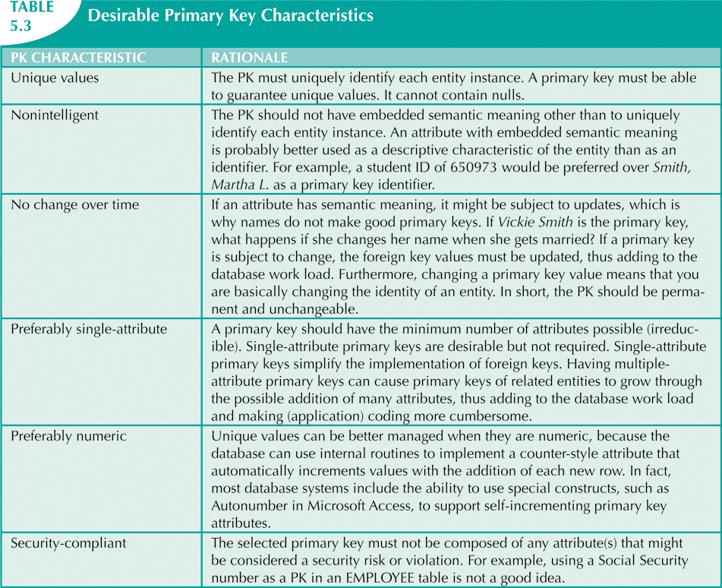

Slide 4
Composite Primary Keys
Composite primary keys are useful as identifiers of composite (or bridge) entities.
Each primary key combination is allowed once in an M:N relationship.
Automatically provides benefit of ensuring that there cannot be duplicate values.
However a surrogate key may be preferred.

Slide 5
Surrogate Primary Keys
Surrogate primary key is:
Created by the database designer or even the DBMS itself.
Used to simplify the identification of entity instances.
Usually a numeric, single attribute, key that increases by 1 for each row in the table.
Especially helpful when there is:
No natural key.
Selected candidate key has embedded semantic contents.
Selected candidate key is too long or cumbersome.
However, may need to ensure uniqueness of other columns as well, by specifying constraints.

Slide 6
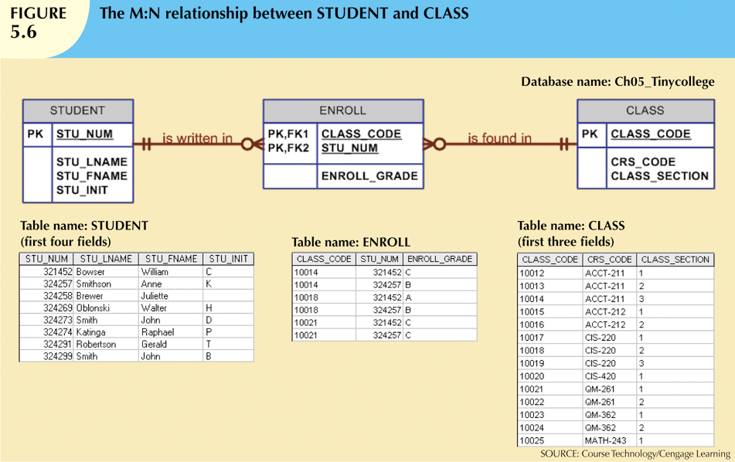
Composite PK Example

Slide 7
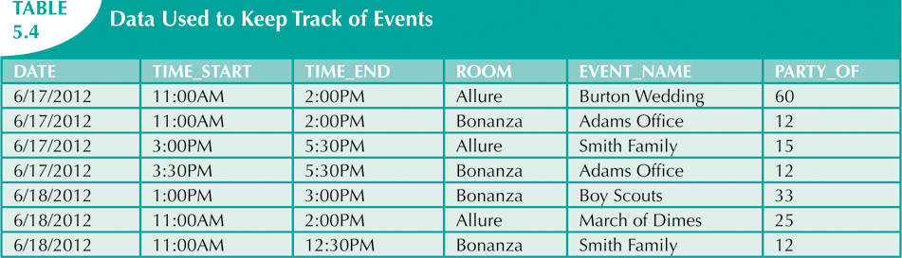
What would you choose for PK?
For uniqueness, need DATE, TIME_START and ROOM in the PK.
May get very clumsy (particularly if there is an M:N relationship between
events and resources. In that case the bridge entity will need even more
attributes in its PK).
Give each event its own number – surrogate key.
Then need a uniqueness constraint on (DATE, TIME_START, ROOM).

Slide 8
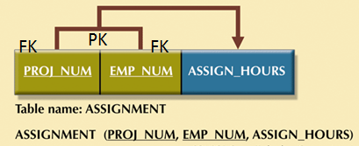
Refine Primary Keys
In ASSIGNMENT Table, is ASSIGN_HOURS the hours worked per year or month or week or day?
This matters!
PROJ_NUM and EMP_NUM seem like a good PK.
What if the hours are recorded weekly?
Might have multiple rows with the same PK (an integrity violation).
Even if we add ASSIGN_DATE, what if multiple entries are made per day?
Better to add a surrogate key (ASSIGN_NUM).

Slide 9
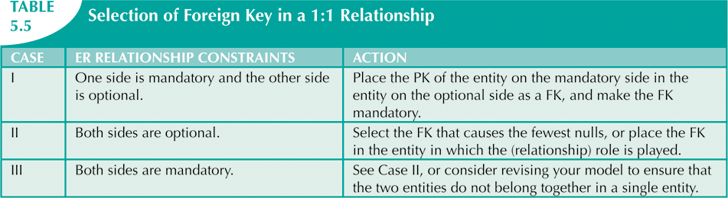
Implementing 1:1 Relationships
Foreign keys work with primary keys to properly implement relationships in the relational model.
In a 1:1 relationship, there are three options:
One of the entities is really an attribute.
Place a foreign key in both entities (not recommended).
Place a foreign key in one of the entities.
Primary key of one entity appears as foreign key of other.

Slide 10
Maintaining History of Time-Variant Data
Normally, existing attribute values are replaced with new values and the previous values are gone.
Time-variant data:
Values change over time.
Must keep a history of data changes.
Create a new entity in 1:M relationship with original entity.
New entity contains new value, date of change, and any other additional information.

Slide 11
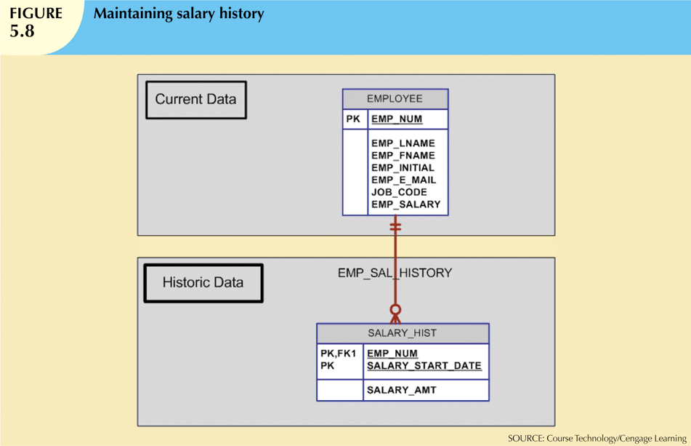

Slide 12
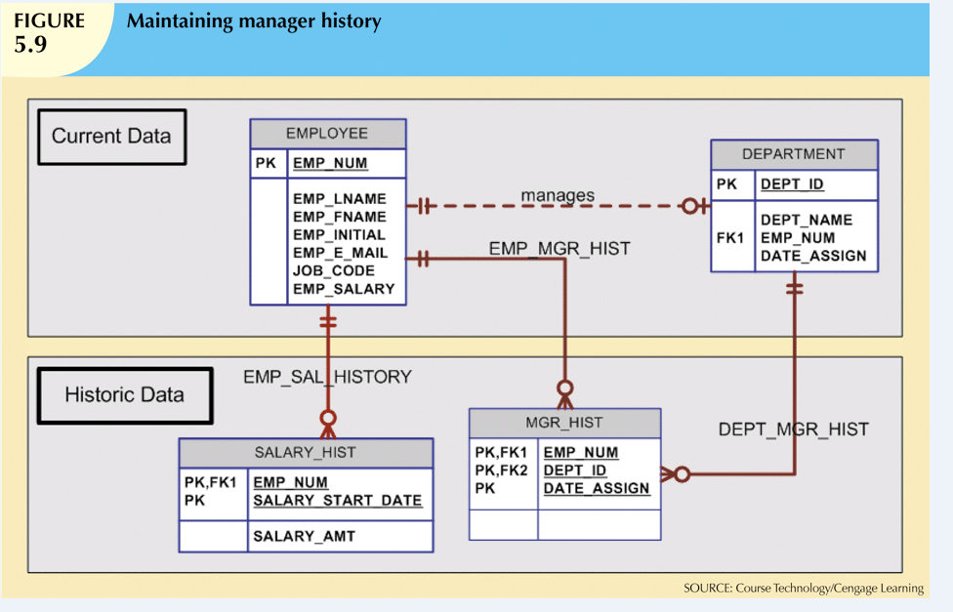

Slide 13
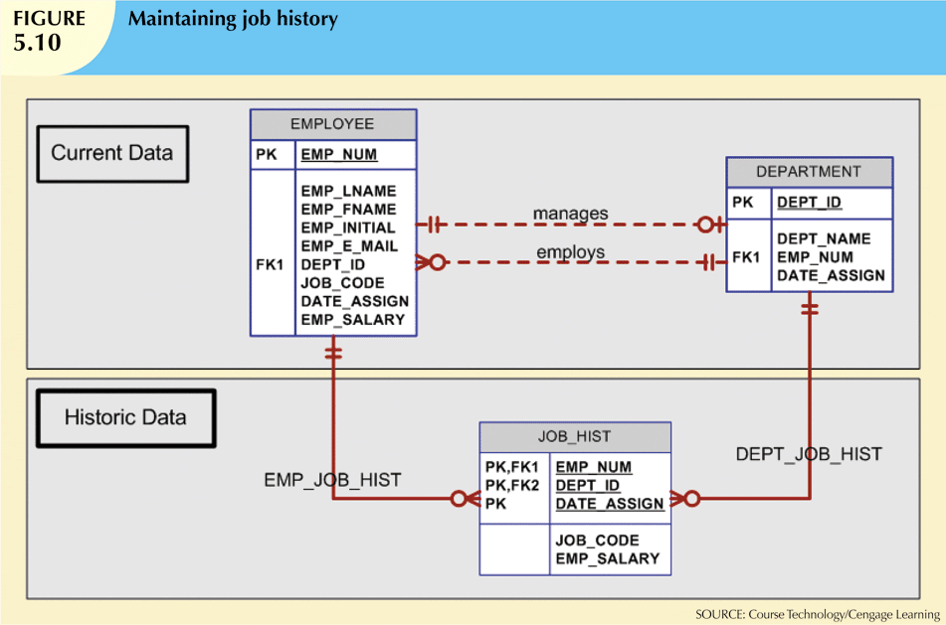
Confusing use of 2 DATE_ASSIGN attributes! The one in the DEPARTMENT table
is for the manager, not the employee.

Slide 14
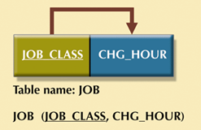
Evaluate Names
Look over all attribute names.
Are they descriptive?
Are they named consistently?
Do they indicate which relation (table) they are part of?
For example, in JOB (JOB_CLASS, CHG_HOUR):
CHG_HOUR should be JOB_CHARGE_HOUR.

Slide 15
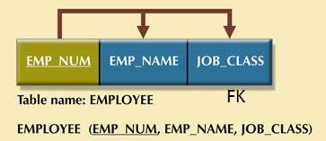
Refine Attribute Atomicity
Want atomic (or simple) attributes - attributes that cannot meaningfully be broken down any further.
Atomic attributes increase query flexibility.
E.g. in the EMPLOYEE relation
EMPLOYEE (EMP_NUM, EMP_NAME, JOB_CLASS)
EMP_NAME should be broken into EMP_FIRSTNAME, EMP_LASTNAME, EMP_INITIAL.
(And JOB_CLASS should be renamed EMP_JOB_CLASS).

Slide 16
Identify Additional Attributes and Relationships
Attributes
Examine the list of attributes to determine if any are missing.
Example, the EMPLOYEE table should contain EMP_SSN, EMP_HIREDATE, EMP_SALARY, and so on.
Relationships
Look for missing relationships that were not documented in the business rules.

Slide 17
Consider Adding Derived Attributes
A derived attribute is an attribute whose value is obtained by a calculation applied to existing attributes.
E.g. The charge per employee per project can be derived (calculated) from JOB_CHARGE_HOUR * ASSIGN_HOURS.
Derived attributes do not need to be added to the table, since their value can always be calculated if needed for queries or reports.
But it may save time to add the attribute to the table; calculate and store the value only once, as the row is entered.

Slide 18
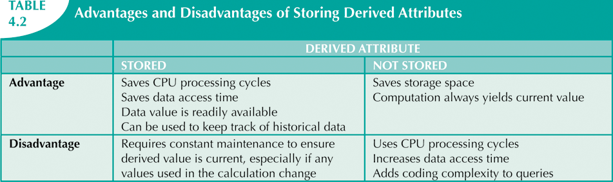
Consider Adding Derived Attributes
NOTE: Derived attributes violate normalization – see later.
They also need to be updated every time any of the source columns is changed.
An alternative to adding the attribute as a column is to use a view – a table which is not stored in the database but which is computed from an existing table and is updated when the source table changes (see later).

Slide 19
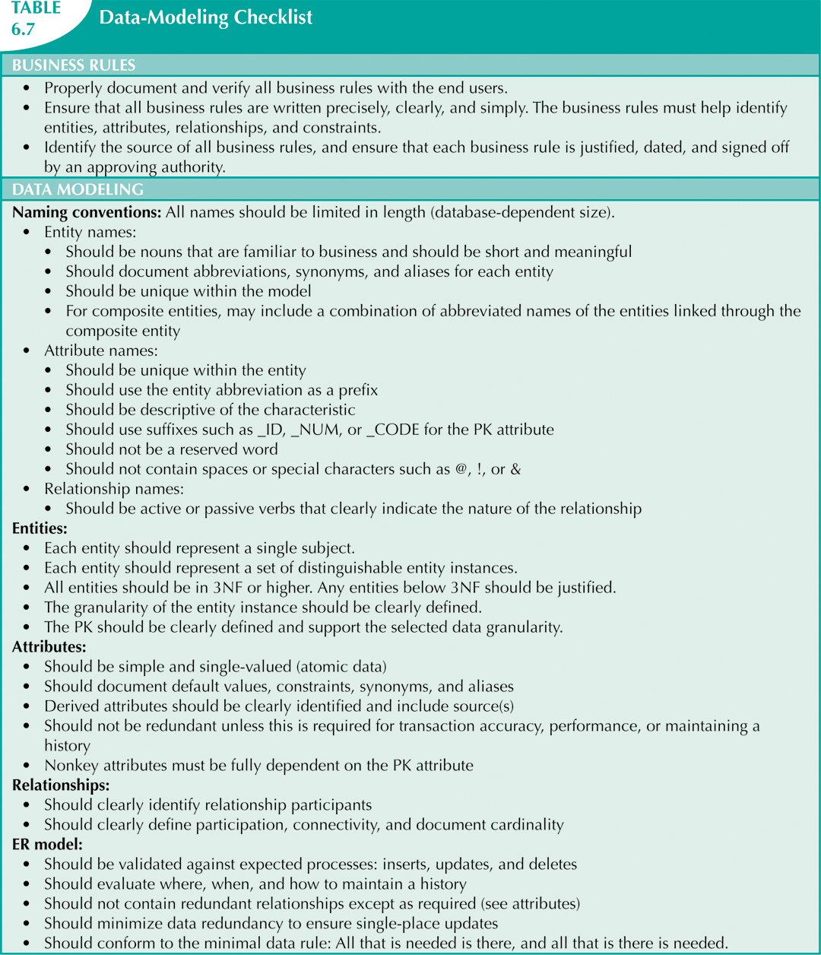

Slide 20
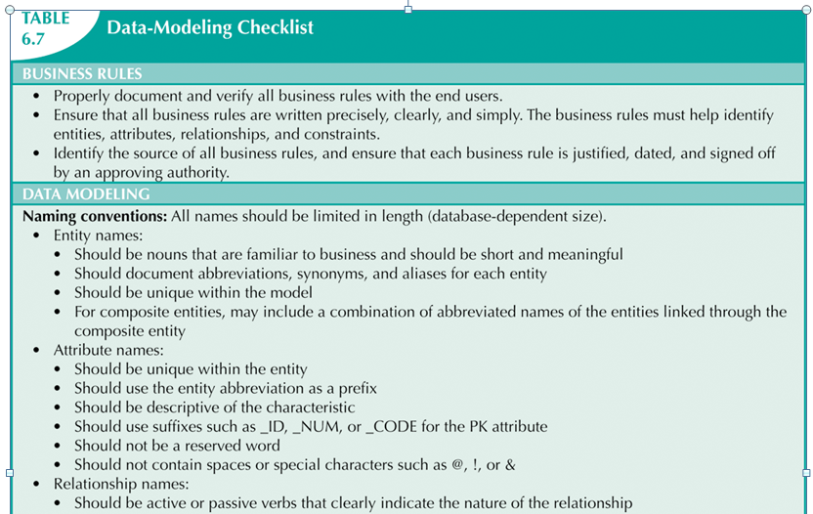
Data-Modeling Checklist (2 slides)

Slide 21
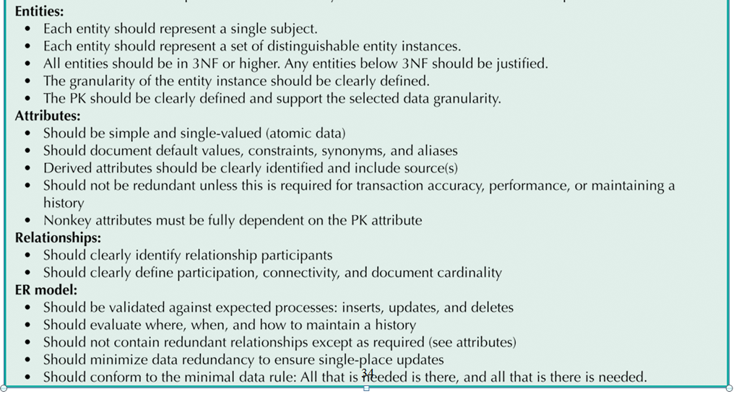
Data-Modeling Checklist (ctd)

